Slide 1
Lecture No. 18
Combinational Functional Devices

Slide 2
Multiplexer
Multiplexer: is a device that allows digital information from several sources to be routed onto a single line for transmission over that line to a common destination.
The basic multiplexer has several data input lines and single output line.
Multiplexer are also known as data selectors.
Notes:
3 minutes
6 minutes

Slide 3
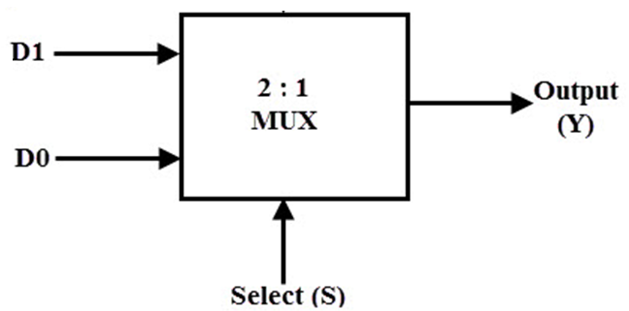
Multiplexer
  2-to-1 Multiplexer(BLOCK DIAGRAM)
Notes:
3 minutes
6 minutes

Slide 4
Multiplexer
  2-to-1 Multiplexer(TABLE)
S | D0 | D1 | Y
0 | 0 | 0 | 0
0 | 0 | 1 | 0
0 | 1 | 0 | 1
0 | 1 | 1 | 1
1 | 0 | 0 | 0
1 | 0 | 1 | 1
1 | 1 | 0 | 0
1 | 1 | 1 | 1
S.D0D1 | D₀D₁ | D₀D₁ | D₀D₁ | D₀D₁
 | 00 | 01 | 11 | 10
S’ =0 | 0 | 0 | 1 | 1
S=1 | 0 | 1 | 1 | 0
Notes:
3 minutes
6 minutes

Slide 5
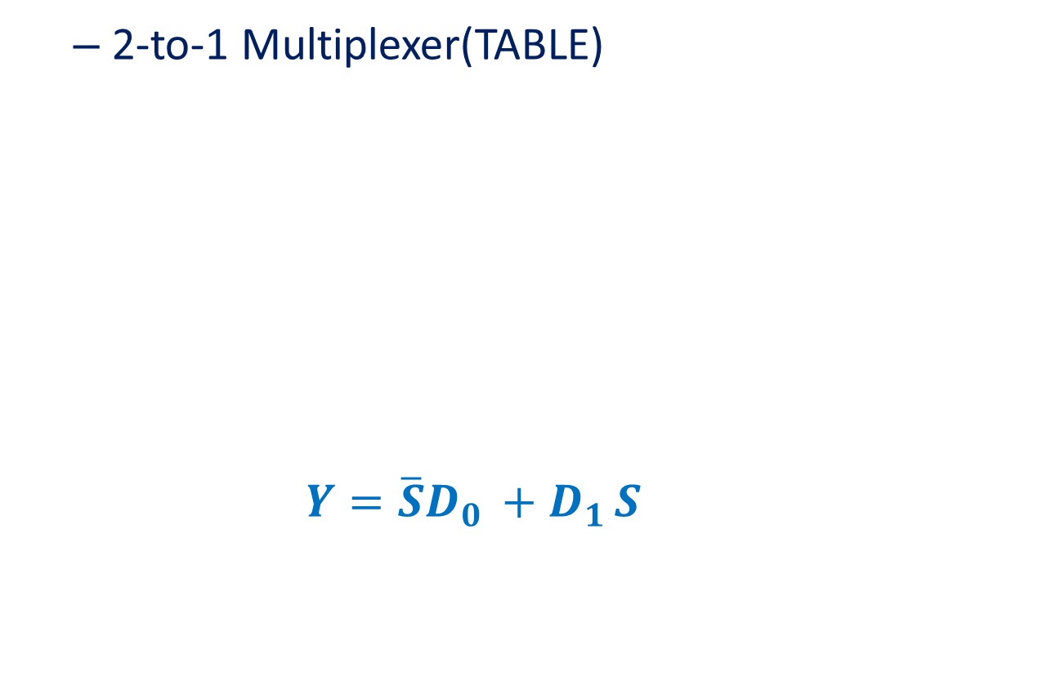
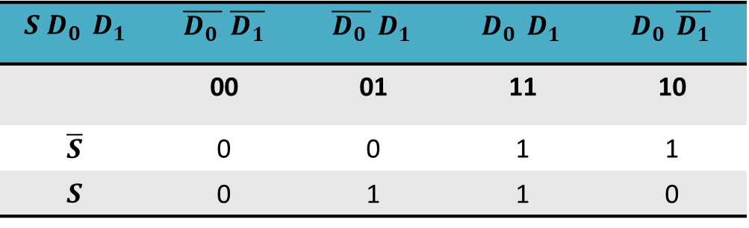
Multiplexer
Notes:
3 minutes
6 minutes

Slide 6
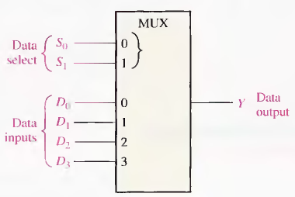
Muliplexer
  4-to-1 Multiplexer
Notes:
3 minutes
6 minutes

Slide 7
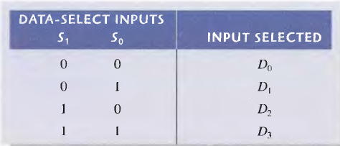
Muliplexer
  4-to-1 Multiplexer
Notes:
3 minutes
6 minutes

Slide 8
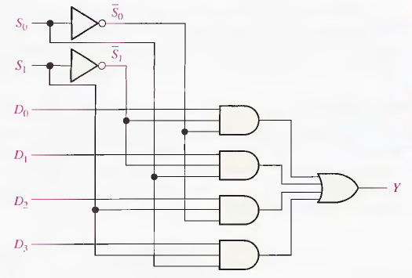
Muliplexer
  4-to-1 Multiplexer
Notes:
3 minutes
6 minutes

Slide 9
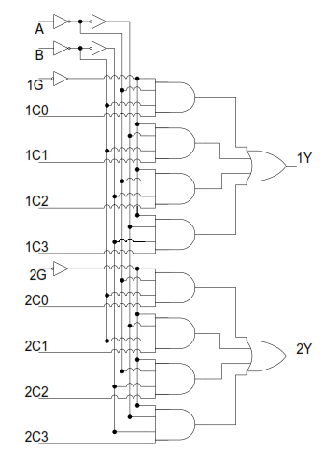
Muliplexer
  Dual 4-input Multiplexer (74XX153)
Notes:
3 minutes
6 minutes

Slide 10
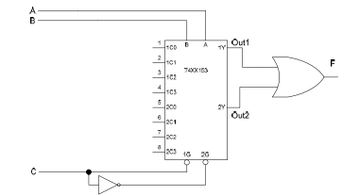
Multiplexer
Expanding Mux
  8-input Mux 74X153
Notes:
10 minutes
16 minutes

Slide 11
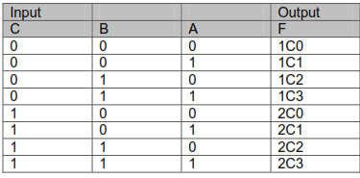
Multiplexer
  8-input Mux 74X153
Notes:
10 minutes
16 minutes

Slide 12
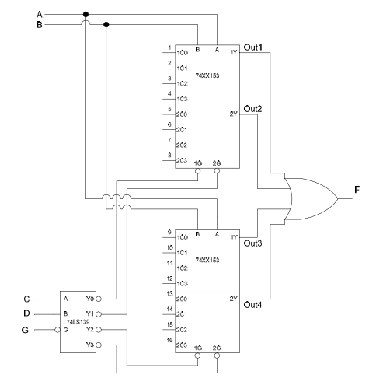
Multiplexer
  16-input Mux
Notes:
10 minutes
16 minutes

Slide 13
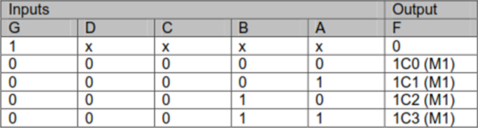
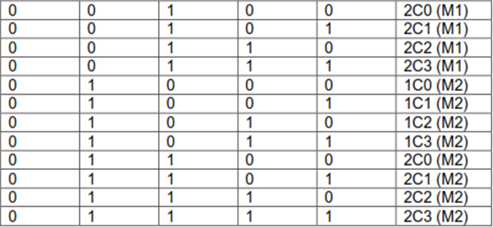
Multiplexer
2-input, 8-bit Mux (74x157)
Notes:
10 minutes
16 minutes

Slide 14
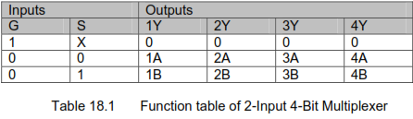
Multiplexer
2-Input 4-bit Mux (74XX157)
Notes:
10 minutes
16 minutes

Slide 15
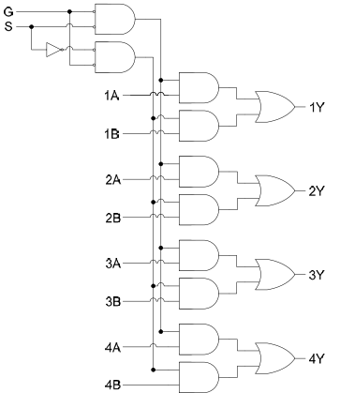
Multiplexer
2-Input 4-bit Mux (74XX157)
Notes:
10 minutes
16 minutes

Slide 16
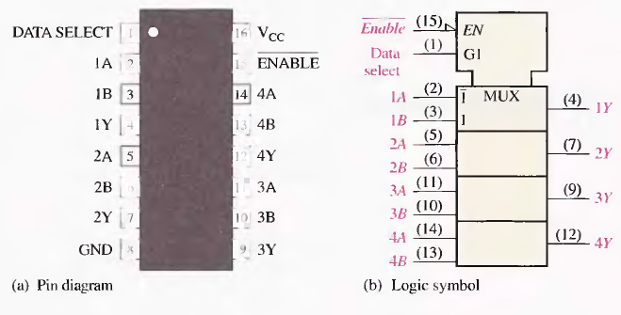
Multiplexer
2-Input 4-bit Mux (74XX157)
Notes:
10 minutes
16 minutes

Slide 17
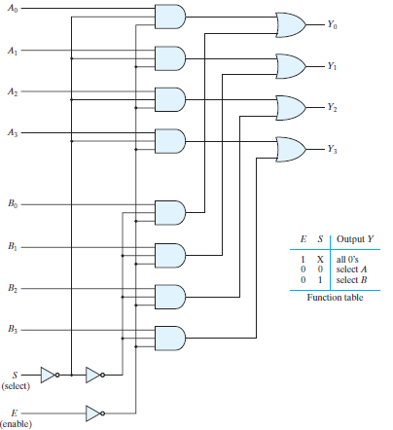
Multiplexer
2-Input 4-bit Mux
Notes:
10 minutes
16 minutes

Slide 18
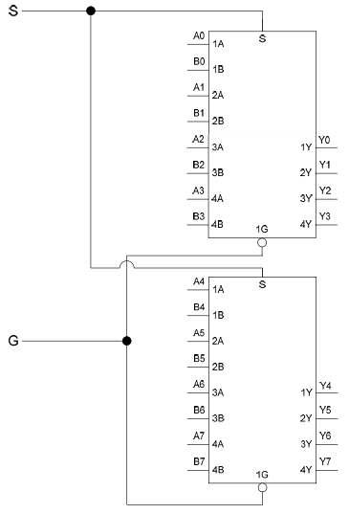
Multiplexer
2-input, 8-bit Mux (74x157)
Notes:
10 minutes
16 minutes

Slide 19
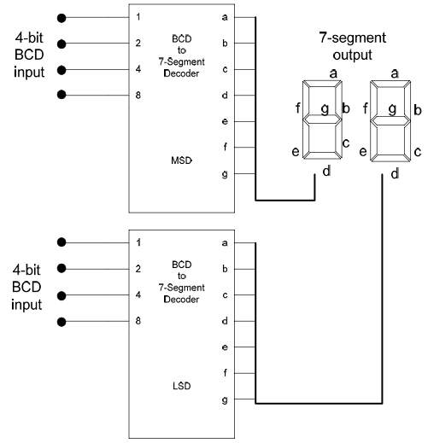
MUX Applications
2-Digit Decimal Display circuit
Notes:
12 minutes
28 minutes

Slide 20
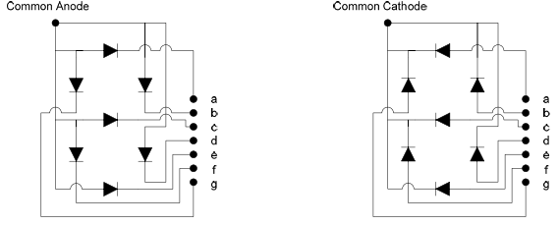
MUX Applications
  Common Cathode/Anode Displays
Notes:
12 minutes
28 minutes

Slide 21
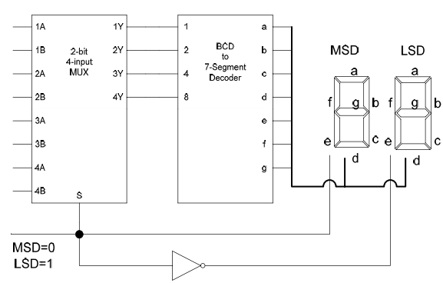
MUX Applications
  2-Digit Mux based Display circuit
Notes:
12 minutes
28 minutes

Slide 22
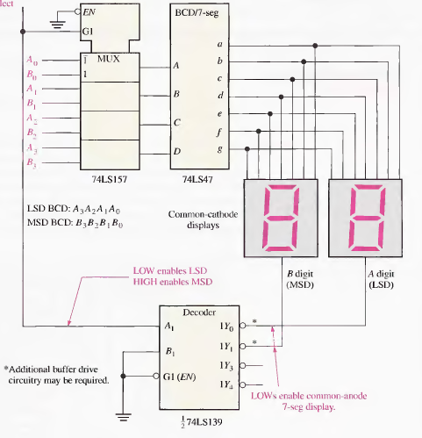
MUX Applications
  2-Digit Mux based Display circuit
Notes:
12 minutes
28 minutes

Slide 23
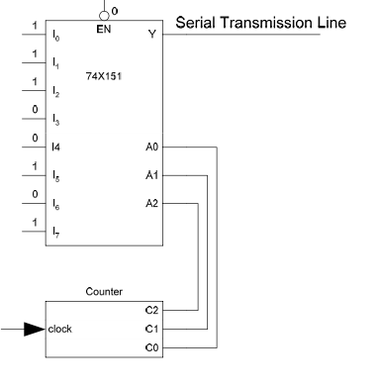
MUX Applications
Parallel to Serial
Notes:
12 minutes
28 minutes

Slide 24
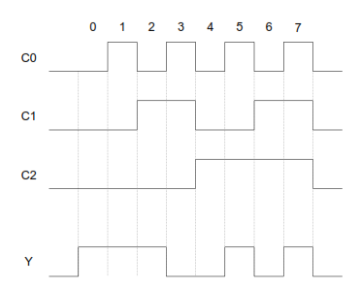
MUX Applications
Parallel to Serial
Notes:
12 minutes
28 minutes

Slide 25
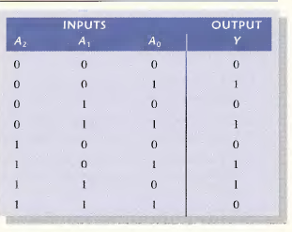
MUX Applications
Function Generators
Notes:
12 minutes
28 minutes

Slide 26
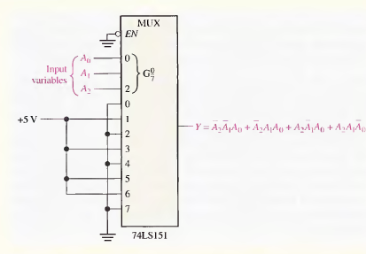
MUX Applications
Function Generators
Notes:
12 minutes
28 minutes

Slide 27
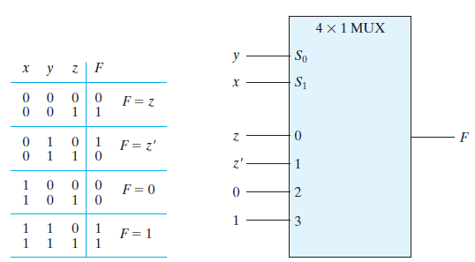
MUX Applications
Function Generators
Notes:
12 minutes
28 minutes

Slide 28
Multiplexer
X | Y | Z | F
0 | 0 | 0
0 | 0 | 1
0 | 1 | 0
0 | 1 | 1
1 | 0 | 0
1 | 0 | 1
1 | 1 | 0
1 | 1 | 1

Slide 29
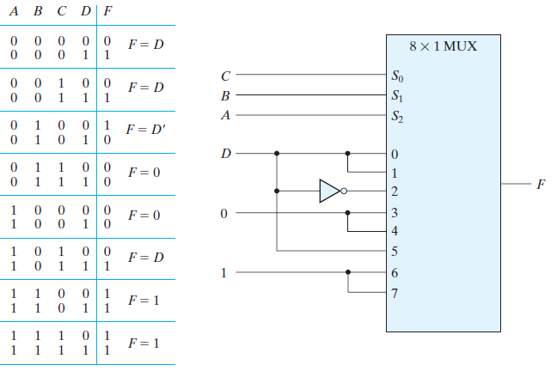
MUX Applications
Function Generators
Notes:
12 minutes
28 minutes

Slide 30
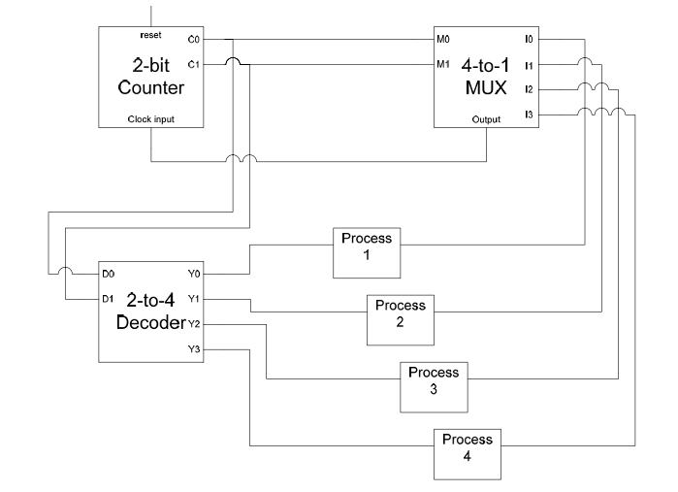
MUX Applications
Operation Sequencing
Notes:
12 minutes
28 minutes

Slide 31
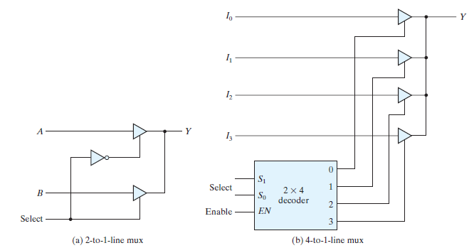
MUX with Three State Gate
Notes:
12 minutes
28 minutes

Slide 32
Demultiplexer
Demultiplexer: Reverse operation of MUX.. Takes data from one line and distributes it to a given number of lines.
A DE Multiplexer is also known as data distributor.
Notes:
4 minutes
10 minutes

Slide 33
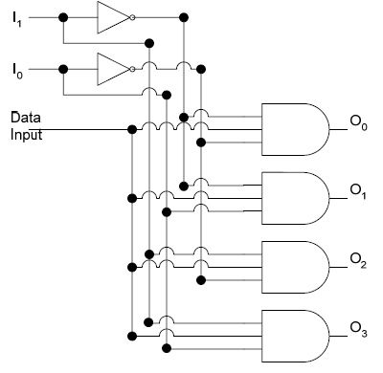
Demultiplexer
1-to-4 Demultiplexer
Notes:
4 minutes
10 minutes

Slide 34
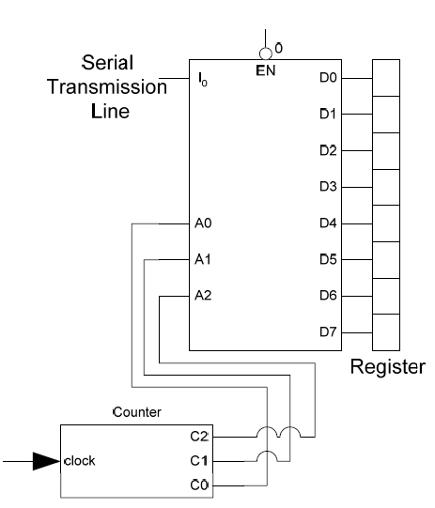
Demultiplexer
ALU to Register connection
Series to Parallel Converter
Notes:
4 minutes
10 minutes

